Slide 1
Suppose the CD rates stay unchanged over the year, then the total returns of the CDs are
Compounding frequency matters!
1.021305255
1.021369136
1.021413423
1.021400000
1.021305255
1.021369136
1.021413423
1.021400000
1.021305255
1.021369136
1.021413423
1.021400000

Slide 2
Popular Compounding Frequencies
ω=1, annual compounding (Euro bonds)
ω=2, semiannual compounding (USD bonds)
ω=4, quarterly compounding (floating-rate notes)
ω=12, monthly compounding (mortgages)
ω=365, daily compounding (saving accounts)
ω=∞, continuous compounding (for theoretical modeling)

Slide 3
Interest rates and Compounding Frequencies
Investing F at a rate of r compounded semiannually for T years generates
Let ω be the compounding frequency, then the final balance is

Slide 4

Continuous Compounding
When ω$→$∞,
$$\lim_{\text{ω}→\text{∞}}{F{×\left(1+\frac{\hat{r}}{ω}\right)}^{ωT}=Fe^{\hat{r}T}}$$

Slide 5



Semiannual Compounding
One of the most common definition of return rate is associated with semi-annual compounding
$${\left(1+\frac{r}{2}\right)}^{n}$$
$${\left(1+\frac{r}{2}\right)}^{2}$$
$$1+\frac{r}{2}$$
1
………..
6 months
6 months

Slide 6
Investment Comparison
Two example
a $100m 1-year loan that pays $102,521,281 in one year
a $100m 1.5-year loan that pays $103,797,070 in 1.5 years
Which one is a better investment?

Slide 7
The Rate of Return
For the first loan, the rate of return is implied by
Solve it and obtain r₁=2.5125%.
For the second loan, the rate of return is implied by
Solve it, we obtain r_{1.5}=2.5%.
The 1Y loan is more attractive.

Slide 8
Rate of return and discount rate
We can also write
and
A return rate is also the discount rate.

Slide 9
Present Value vs. Future Value
For a future cash flow, , its corresponding present value is
Relative to , is called the future value.
Future value
Present value

Slide 10
Important Linear Securities Swaps
From Chapter 18

Slide 11
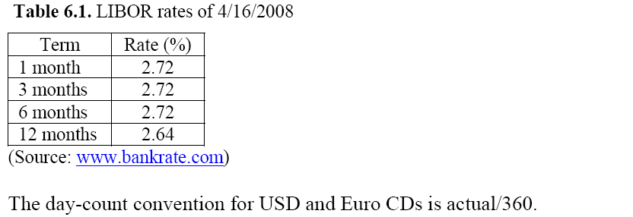
LIBOR Rates
LIBOR is a set of reference interest rates at which banks lend unsecured loans to other banks in the London wholesale money market.
The LIBOR rates are benchmark rates for certificates of deposit (CDs).
Bank Rates

Slide 12
Interest Rate Swaps
Parties A & B agree, on May 28, 2010, to enter into an interest rate swap with the following terms. Starting in two business days, on June 2, 2010,
party A agrees to pay a fixed rate of 1.235% on a notional amount of $100 million to party B for two years,
party B, in return, agrees to pay three-month LIBOR (London Interbank Offered Rate) on this same notional to Party A.

Slide 13
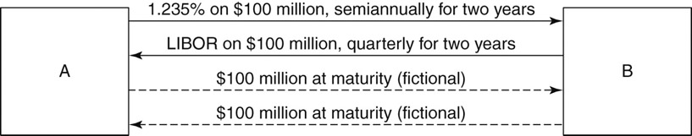
Interest Rate Swaps, cont’d
Figure 2.1: An Example of an Interest Rate Swap

Slide 14
Cash-Flow Pattern
The dash-line arrow means uncertainty
The red-line is the artificial principal

Slide 15
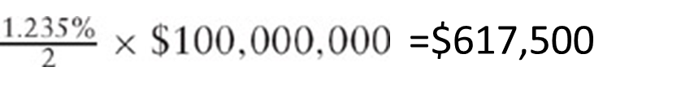
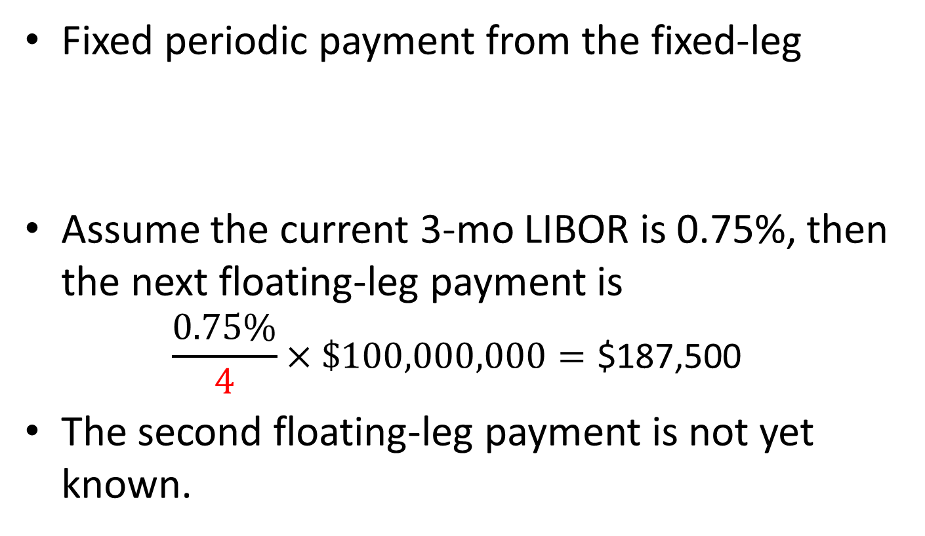
Cash Flow Calculation
Fixed periodic payment from the fixed-leg
Assume the current 3-mo LIBOR is 0.75%, then the next floating-leg payment is
$$\frac{0.75\%}{4}×\$100,000,000=\text{\$187,500}$$
The second floating-leg payment is not yet known.

Slide 16
Pricing of Swaps
The cash flows are generated from
A fixed-rate bond with semiannual payments
A floating-rate bond with quarterly payments
To price the swap, we may present value the cash flows.
The fixed-leg is about a usual bond pricing.

Slide 17
Artificial Principal for Swaps
We principal payments to both legs

Slide 18
Pricing of Floating Leg
Proposition: Initially and right after a payment, the FRN is worth par.
You start with $100m, save it in three-month certificate of deposits (CDs).
Three month later, you collect and pay the interest, and save the remaining $100m to another CD.
Repeat this transaction until the maturity of the swap.

Slide 19
Pricing of Swaps
So the price of a swap is the difference between a coupon bond and its par value
At initiation, all swap have zero value, meaning the values of the fixed legs are also par.
The fixed-leg is a par bond, and the swap rate is a par yield.

Slide 20
Par Bond Recalled
Price-yield relationship
Par bond: when c = y, P(T) = 1.

Slide 21

Determination of PAR Yields
Let be the $T$-year par rate, then
Swap rate formula

Slide 22
Determination of PAR Rates, cont’d
Let
Then
Alternative formula for general bond price

Slide 23


The Calculations
Equations for the discount factors
Table 2.1

Slide 24
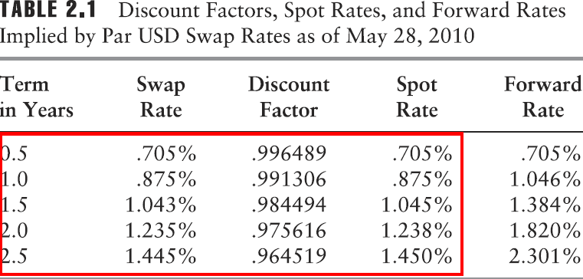
Spot Rates and Discount Factors
Table 2.1 also gives the spot rates from the USD swap curve as of May 28, 2010.

Slide 25
Why Swaps?
To lock in long-term low interest rate to pay to high interest rate to receive.
To speculate.
To hedge other interest-rate sensitive securities/portfolios.

Slide 26
MtM Swaps
What is the price of the swap at a later time

Slide 27
PV the two legs
At time , the swap rate is . At a later time , what should be the MTM value of the swap?
Answer: For the fixed leg, the value is

Slide 28
PV the two legs
For the floating leg, when , the value is
When , the value is

Slide 29
MtM Swaps, cont’d
At other later time , the MtM value of the swap is

Slide 30
General Swap Rate Formula
Define the general swap rate formula

Slide 31
General MtM value of Swaps
So the value of the swap becomes

